Slide 1
ADIDAS HACKATHON 2018
BOBBY TABLES

Slide 2
52,000,000
in Europe alone
75%
run with music

Slide 3
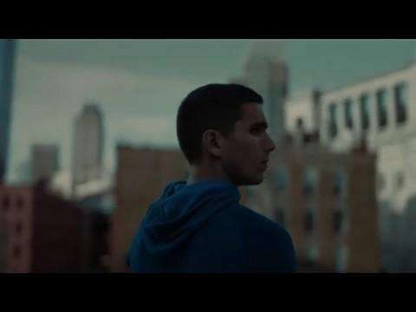

Slide 4

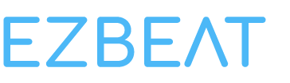

Introducing...
Run to songs that match your pace. Keep your rhythm. Boost your performance.

Slide 5





HOW IT WORKS

Slide 6


SHOW ME THE MONEY!
Build a community of sport lovers
Profit!
Engage users with a fully functional lite version
Offer them premium features that they crave

Slide 7
NEXT STEPS
improving the current build

Slide 8
Build you perfect training session
5km

Slide 9
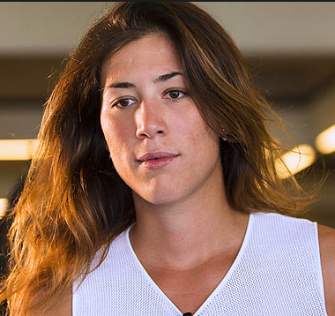
Curated content from the world’s top performers
Garbiñe Muguruza
Daily sesh
...
Pre-game run
...
Light mode
...
Half marathon
...
Random jamz
...

Slide 10
In house recommendation engine
For improved scalability and performance.

Slide 11



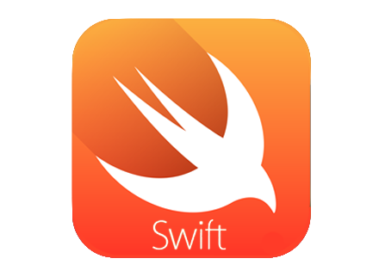

APIs
Technologies

Slide 12
DEMO TIME

Slide 13
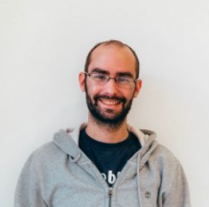
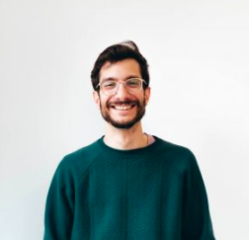
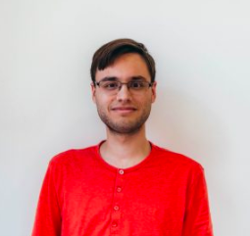
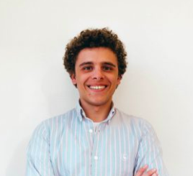
TEAM BOBBY TABLES
Gabriel Furstenheim
Ricardo Boluda
Lluís Ulzurrun
Ignacio Moreno

Slide 14
Thanks!
Any questions?

